Slide 1
Ahlberg Gear House Equipment Rental Software
Palesa M. Will S. Sasha C.

Slide 2
CLIENT & CONTEXT

Slide 3
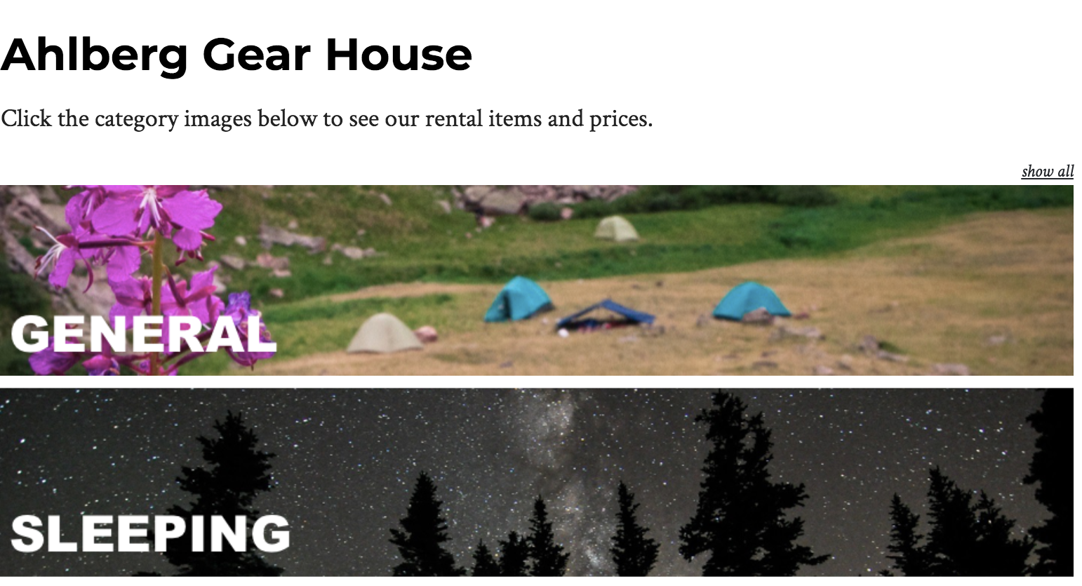

Slide 4
CURRENT SYSTEM:
-Track easy
-Google forms
-Excel
-on paper calculations

Slide 5
Client specifications (in order of importance)
-Desktop Interface for Back End Rental Operations
-User Database (User Name, Email, Phone Number,ID, Discount Awarded)
-Rental Inventory (Itemized and Bulk options, Barcode Assignment, Rental Tracking, Pricing Structure, Inventory Procedure)
-Email capabilities (completed rental agreement, Rental Confirmation, Rental Due Reminder,Overdue Rental Notification)
-Student ID “Swipe” ability to pull user accounts (Ability to connect to Banner data)
-Integrated Waiver/Rental Agreement that must be signed to complete each rental
-Reporting (Ability to pull data on rental numbers, finances,etc.)

Slide 6

Ultimate Goal:
-set up a one stop rental platform
https://marketyou.co/about/shopping_for_digital_services-id-f5c69df9-b801-4e33-9555-38d3bbb2172c/

Slide 7
Goals:
Week 1:
User database
Itemized inventory database
Way to view data
Relationships setup
Week 2:
Functioning rental database (customer and rented gear)
Filter functionality(by gear type -- sleeping/cookware, bulk/itemized)
Rental due reminder
Thinking about ways to store data so that system is maintained after we leave

Slide 8
Development
Using Ruby on Rails
Github for version control
Googledoc for communication
Excel spreadsheets for database seeds

Slide 9


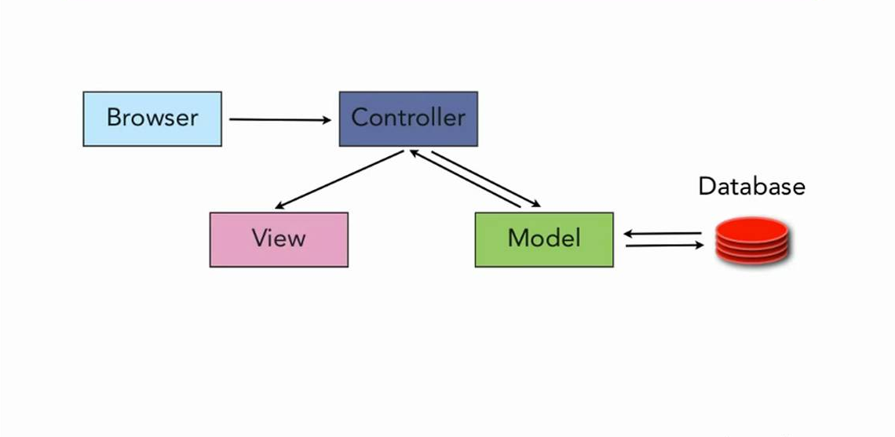
+
MokoenaLee
Scarney23
WillStern

Slide 10
Challenges encountered
-version control merge conflicts
-several moving parts to integrate together
-current spreadsheet formatting not compatible with database
-different host environments (versions not up to date)
-Forsee
-integrating CAS
-means to make data more secure

Slide 11
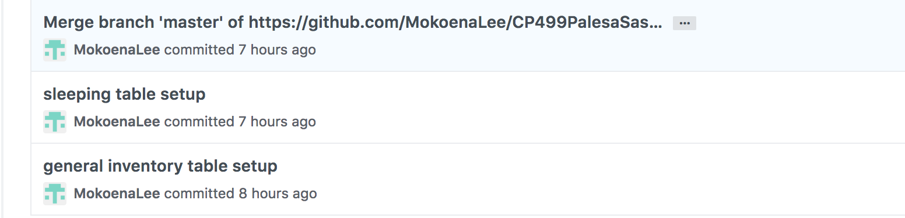
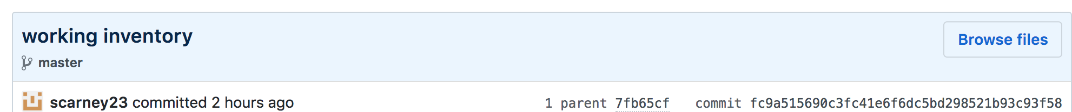
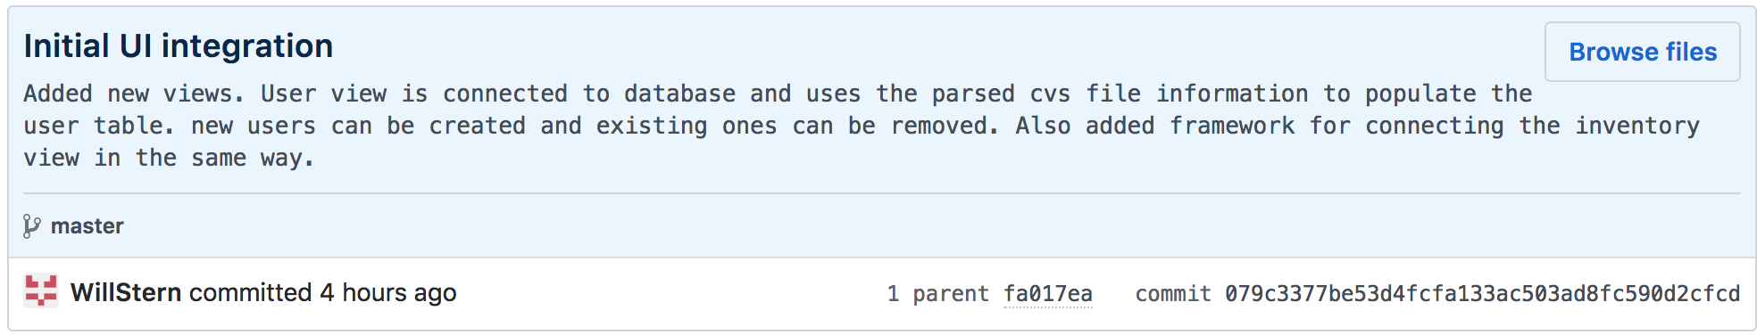
Commit history:

Slide 12
Accomplishments
Demo App Created
Identify a client
Collect requirements
Communicate client’s wants/Needs Identified
Identified structure of execution
Troubleshooting and resolving merge conflicts
Identified resources to consult throughout project process

Slide 13
Q&A:

